Slide 1
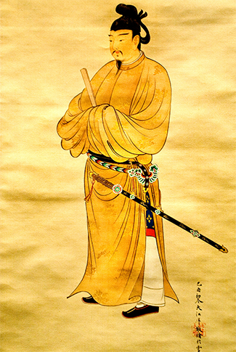
Civilizations of Asia (500-1650)
Lesson 5 The Island Kingdom of Japan

Slide 2
Civilizations of Asia (500-1650)
Topic 3 Lesson 5 The Island Kingdom of Japan
Learning Objectives
Explain how geography set Japan apart.
Understand how China influenced Japan, and describe the Heian period.
Summarize the Japanese feudal system.
Explain how the Tokugawas united Japan.
Identify how Zen Buddhism shaped culture in Japan.

Slide 3
Japan’s Geography
A Mountainous Land
Too mountainous to farm, early people settled in the valleys and plains
The Sea Sets Japan Apart
Japan is far away from China to be conquered but close enough to learn from Korea and China. This allows them to choose what they learn from China
The seas also provide food and also served as a link with the other Japanese islands. It also helped with trade
The Pacific Ring of Fire
This area is subject to frequent earthquakes and volcanoes
Underwater earthquakes can cause tsunamis which are tidal waves
The Japanese will come to fear and respect the dramatic forces of nature

Slide 4
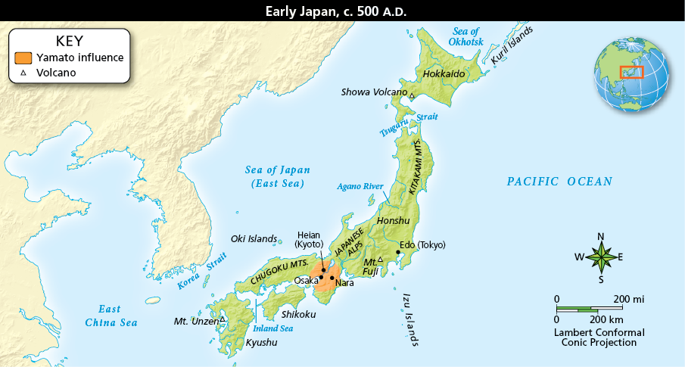
Japan’s Geography
Japan is located on an archipelago. In addition to its four main islands, Japan includes over 3,000 smaller ones. Analyze Maps Explain how two geographic features might have influenced Japanese life.

Slide 5
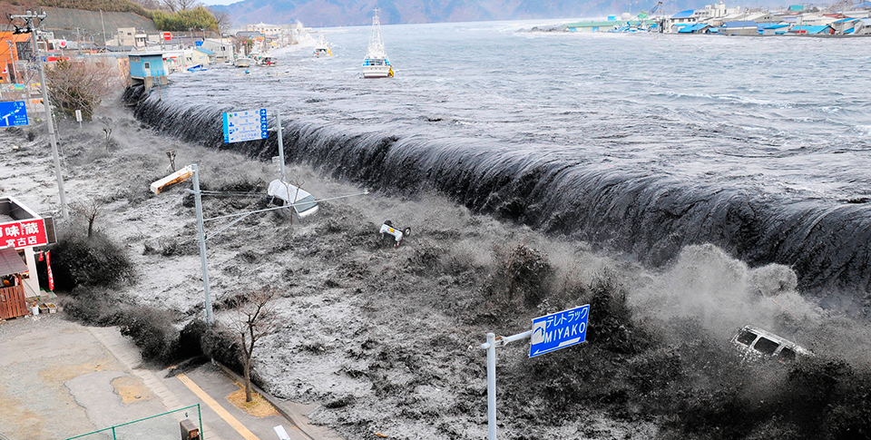
Japan’s Geography
Japan has experienced many tsunamis, which are caused by earthquakes in the sea floor that send out huge surges of water that come ashore with destructive force.

Slide 6
Early Japan
The Yamato Clan
Early Japanese society was divided into clans
About 500 A.D. the Yamato clan will set up Japan’s only dynasty
Emperors will be revered as living gods, and the current Japanese emperor will trace his lineage back to the Yamato
Shinto: A Religion of Nature
Early Jap clans honored kami which are natural or divine beings
The worship of the forces of nature became known as Shinto
Its traditions are still around in present day Japan and shrines are located in beautiful natural surroundings
Contact With Korea
Early contact with Korea brought Korean artisans and metal workers teaching the Japanese
By 500 A.D. Korean missionaries introduce Buddhism to Japan. With it came knowledge of Chinese writing and culture that sparked Japanese interest

Slide 7
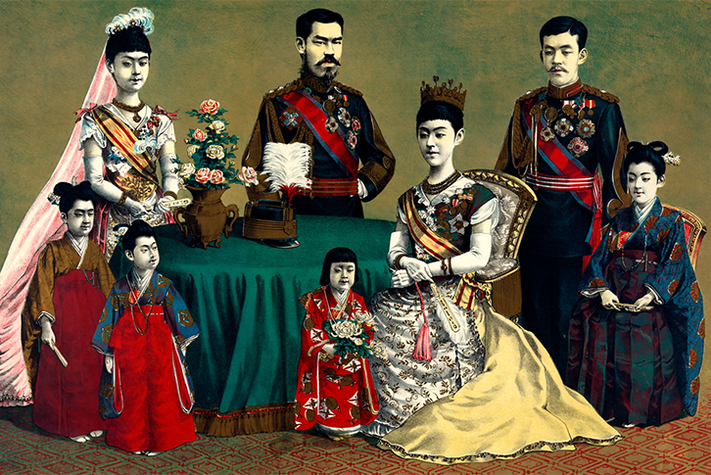
Early Japan
Since A.D. 500, the Japanese emperor has traced his lineage through one clan. Here, the Japanese royal family poses around 1900.

Slide 8
Chinese Influence in Japan
Japan Imports Ideas from Tang China
Japanese are sent to China to learn, bring back Chinese thoughts, technology, arts, and government
They set up a bureaucracy like the Chinese and a law code
In 710 a new capital is built following Tang design. They will do all of these things like Chinese: eat, dress, speak, drink tea, write, dance, and garden
Buddhist and Confucian ideals will also take root
Selective Borrowing
In time the enthusiasm for everything Chinese will die down and the Japanese will keep some ways but discard others
They will not choose officials based on merit like the Chinese but will keep their method of inherited status
When the Tang begin to decline Japan will turn away and begin to modify what they borrowed. They will revise the Chinese system of writing and artist will develop their own style

Slide 9
Chinese Influence in Japan
Prince Shotoku was an advisor to Empress Suiko. He revolutionized Japan by creating a government based on Chinese practices and Buddhist teachings.

Slide 10
Japanese Culture in the Heian Period
An Elegant Court
An elegant and sophisticated culture blossomed that had elaborate rules of etiquette
Courtiers dressed in fine silk
In 900’s Sei Shonagon, a lady in waiting to the empress, wrote “The Pillow Book” with vivid details about court manners, amusements, décor, and dress
Lady Murasaki Writes the World’s First Novel
She is Shonagon’s rival, the name of the book is “The Tale of Genji” written in 1010
She was also a lady in waiting, observing court
Heian Poetry
The novel also includes 800 poems about the Heian court
They provide a detail portrait of life in the Japanese court
Romances like Genji lament that love does not last and beauty is soon gone

Slide 11
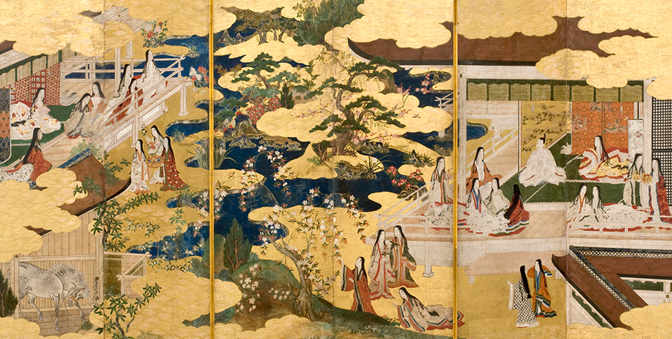
Japanese Culture in the Heian Period
During the Heian period, the wealthy aristocracy established a refined world that led to achievements in art and literature.

Slide 12
Japan’s Feudal Age
A Feudal Society Emerges
The emperor was only a figurehead. Real power was held by the Shogun, supreme military commander
Shoguns only held a small parcel of land, dividing other parcels of lands among other vassal lords named daimyo
Daimyos in turn granted smaller parcels of lands to samurai
Bushido: Way of the Warrior
Samurai were heavily trained warriors who followed a code that emphasized honor, bravery, and absolute loyalty to one’s lord.
Bushido came from Zen Buddhism, Confucianism, and Shintoism
Samurai who betrayed the code or failed had to commit seppuku
Women in Feudal Society
During the age of samurai the position of well born women declined. Unlike chivalry, in Japan women were not placed on a pedestal. She had to accept the same hardships as her husband and owe the same loyalty to his overlord

Slide 13
Japan’s Feudal Age
Other Classes
After the nobility there was peasants, artisans, and merchants
Peasants were 75% of the population
Artisans such as armorers and sword makers provided goods for samurai
Merchants had the lowest status of all but was more wealthy than peasants.
Mongol Invaders Threaten Japan
In 1274 Kublai Khan launches an invasion of Japan after the Japanese refuse to submit to his rule.
30,000 troops arrive but a typhoon arrives shortly and destroys most of the ships
In 1281 a much larger invasion force arrives but yet again another typhoon destroys it, making the Japanese believe that a divine wind ‘kamikaze’ saved them

Slide 14
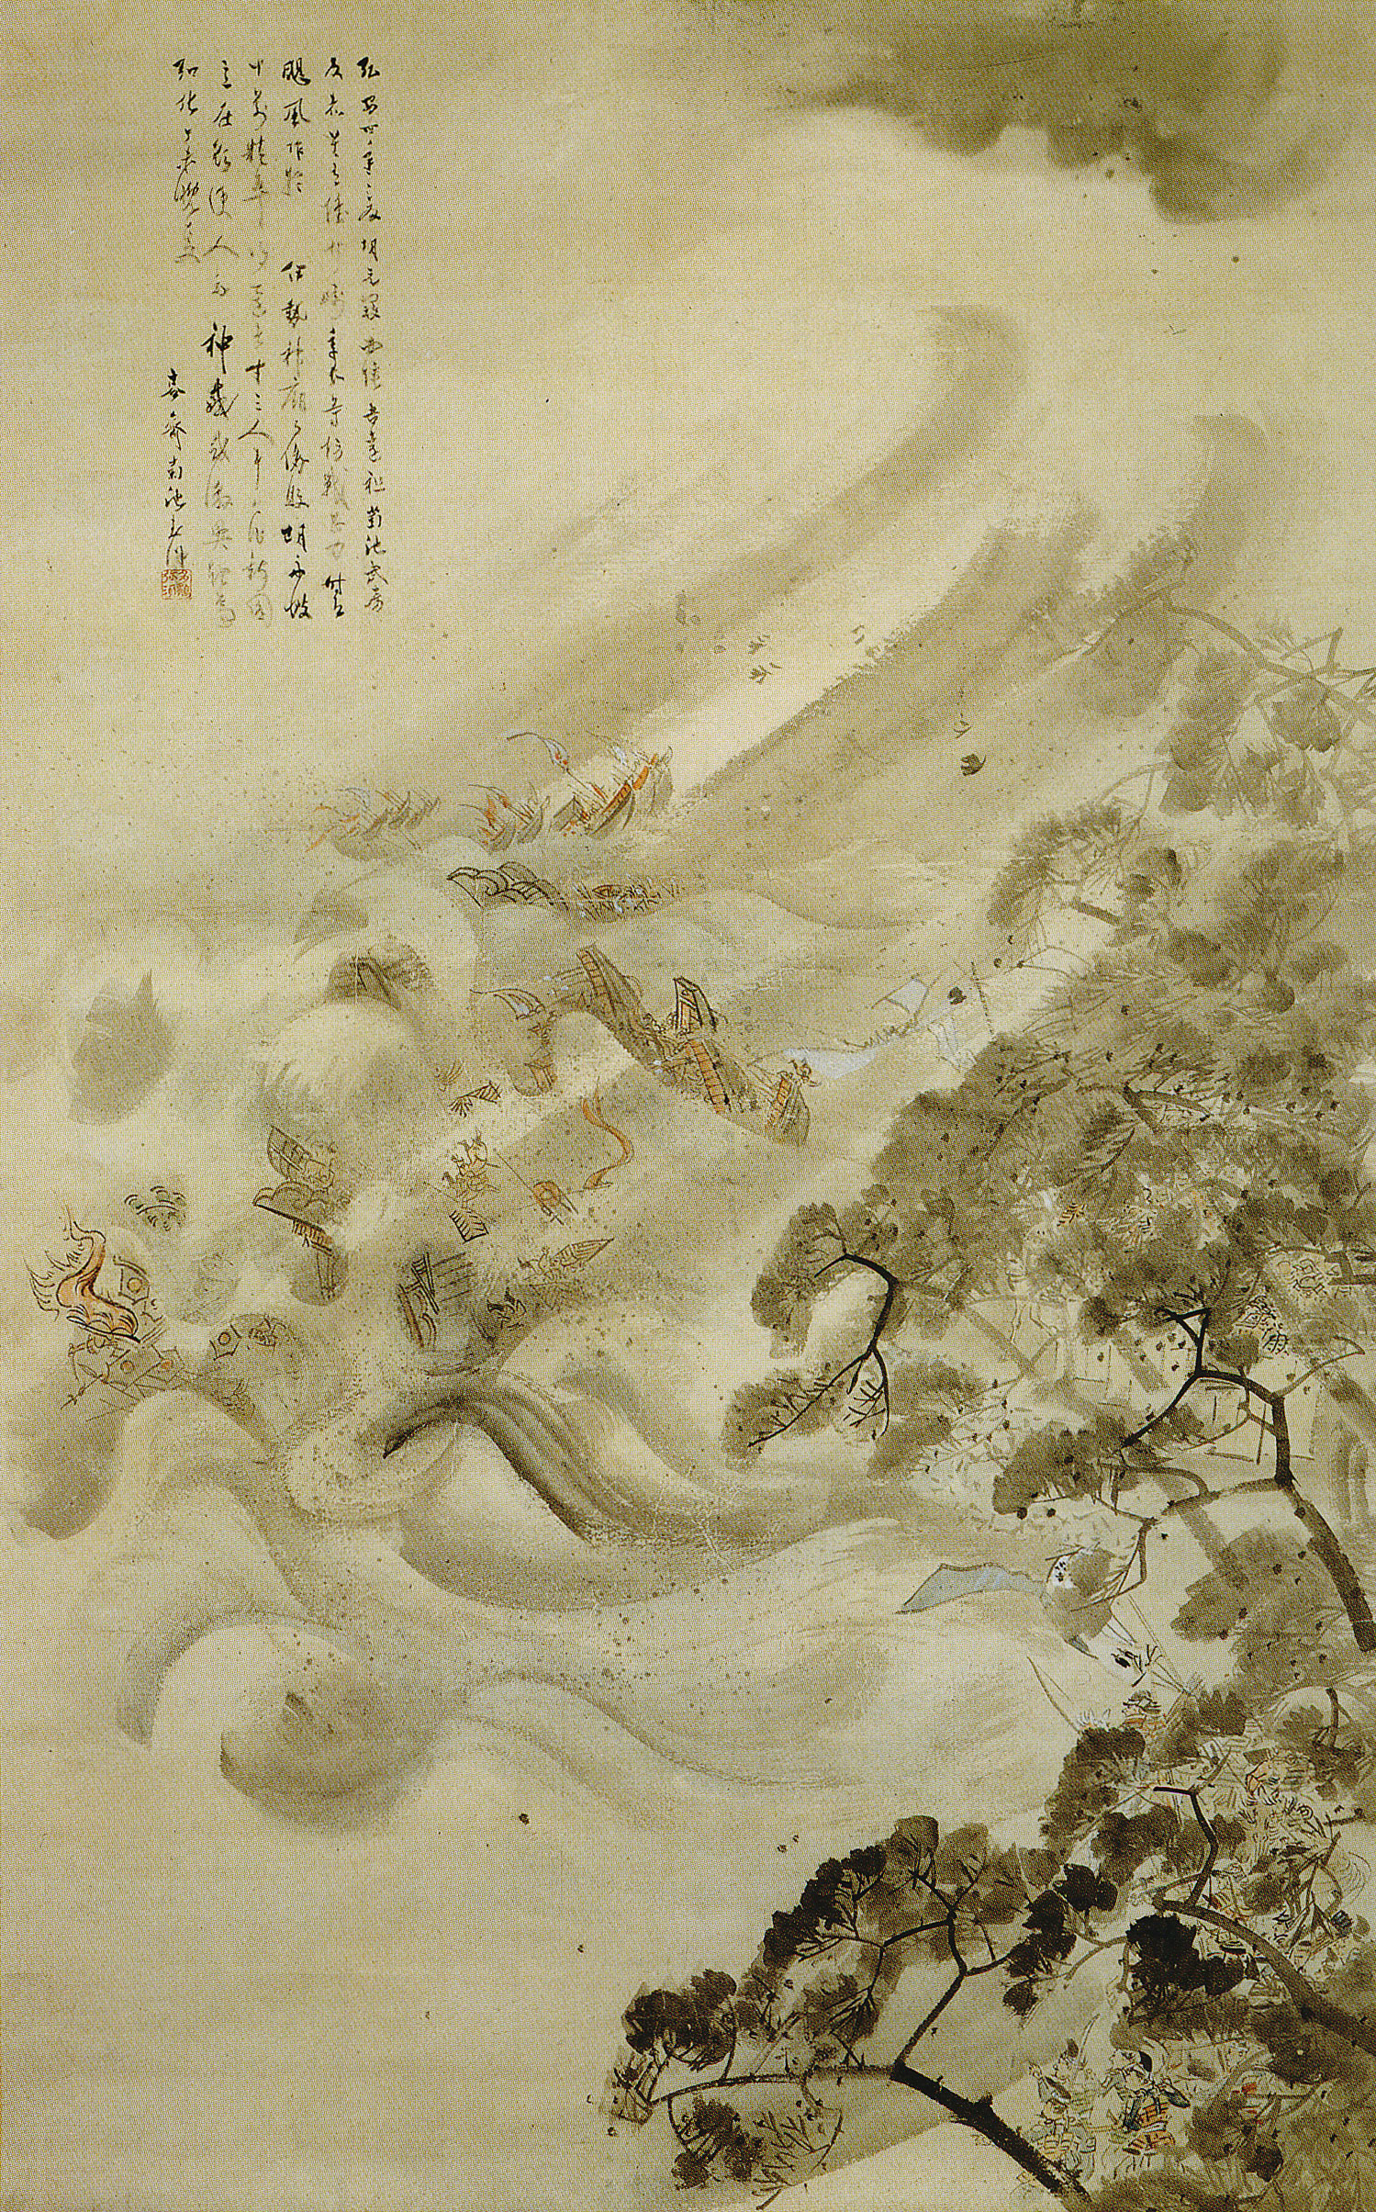

Slide 15
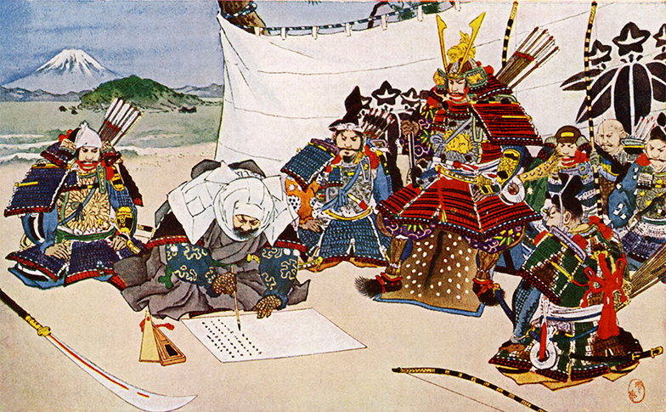
Japan’s Feudal Age
In the 1100s, daimyo Yoshitsune Minamoto (center) appeals to the shogun for forgiveness after being defeated in battle. The shogun refused.

Slide 16
A United Japan
Warriors Gradually Unite Japan
A commoner by birth, General Toyotomi Hideyoshi in 1590 takes over most of Japan
He will then try and fail to take over Korea
After his death Daimyo Tokugawa Ieyasu will take over Japan
Centralized Feudalism
In 1603 Tokugawa will be named Shogun and his shogunate will last until 1868
The shogunate will impose a central govt. control on Japan but keep the outward forms of feudal society. This is called centralized feudalism
In order to control the daimyo they will require that they live in the capital for a year every other year
The daimyo families must live in the capital all year long
Only samurai could hold military position
Peasants could not leave the land

Slide 17
A United Japan
A Booming Economy
With peace coming back trade and agriculture improve
New techniques will increase the food supply
Edo (Tokyo) the capital will grow because artisans will be needed to supply the needs of all the daimyos
With daimyos traveling every year a demand will appear for food and lodgings for them on the way to the capital
Merchants will gain influence among the nobility by lending money to them, some even marrying their daughters to samurai so that their grandchildren will be samurai

Slide 18
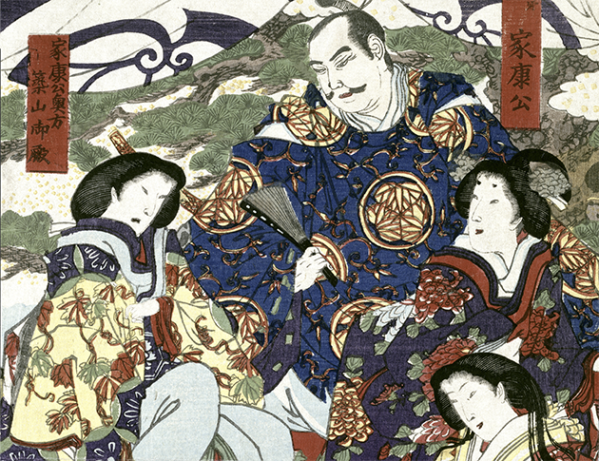
A United Japan
After the Battle of Sekigahara in 1600, Tokugawa Ieyasau seized control of central Japan. He used strict administrative regulations to control anyone who challenged his power.

Slide 19
Japanese Feudal Culture Evolves
Zen Beliefs
Zen has contradictory traditions
Great scholars, but valued the uncluttered mind and the moment on “non-knowing”
They stressed compassion but samurais fought to kill
Zen believe enlightenment could be reached through meditation and precise performance of everyday tasks
Artistic Traditions Change
Under the Tokugawas sophisticated nobles will mix with urban middle class in Edo and Osaka. The urbanites will emphasize luxuries and pleasures and be different from feudal culture that dominated Japan
New Drama Develops
1300’s had Noh plays, ritualized slow plays where movements had meaning, actors wore masks and stories were of fairy tales, Buddhist themes, or daimyo struggles between each other

Slide 20
Japanese Feudal Culture Evolves
New Drama Develops
In the 1600’s towns create Kabuki, plays that were comedies or melodramas but not as ritualized as Noh. They have colorful clothing, lively movement, and exaggerated facial expressions
Bunraku are puppet plays also invented during this time and will be very popular with the middle class
Literature
There will be prose written, usually dealing with Buddhist themes or conflicts between families
Haikus will be invented at this time, 3 lines with 17 syllables
Painting and Printmaking
Japanese painting will reflect Chinese influence but will develop their own styles
In the 1600’s woodblock prints will be made to satisfy middle class taste and giving us an idea of town life in Japan

Slide 21
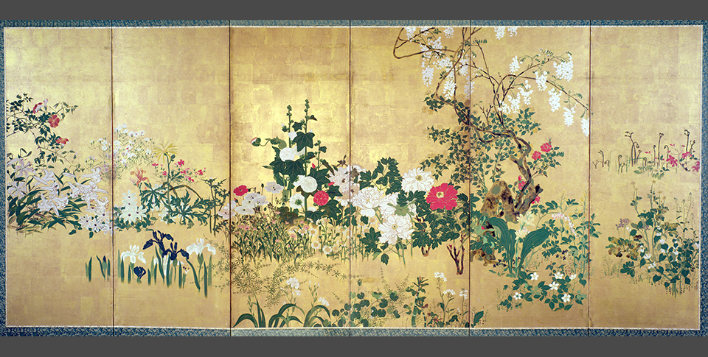
Japanese Feudal Culture Evolves
This painting, Flowers of the Four Seasons (ink and watercolor on gold leafed paper), by Shiko Watanabe (1683–1755) demonstrates the Zen ideal of subtle suggestion.

Slide 22
Quiz: Japan’s Geography
Why do tsunamis pose a great threat to Japan?
A. They cause the Ring of Fire to get worse.
B. They create hurricane strength winds that sweep inland into populated areas.
C. They occur at the same time volcanoes erupt.
D. They strike coastal areas where many Japanese live.

Slide 23
Quiz: Early Japan
How did the Yamato clan affect Japan in the long term?
A. They developed Shinto and helped it spread to other countries.
B. Their homeland became the center of Japanese government, and they established Japan’s only dynasty.
C. They warred frequently with Korea and China, until finally defeating them.
D. They sent Buddhist missionaries to Korea, where it became the national religion.

Slide 24
Quiz: Chinese Influence in Japan
Why did Japan adopt elements of Chinese society?
A. They believed some Chinese practices were superior to theirs.
B. The Chinese invaded Japan and forced their ways on the Japanese.
C. The Koreans adopted Chinese customs first.
D. Japanese society and government were failing and needed to be replaced.

Slide 25
Quiz: Japanese Culture in the Heian Period
Why did the Fujiwara have to use marriage to gain power?
A. They could not perform traditional religious ceremonies.
B. They could not produce great works of literature.
C. Their heirs could not become emperors.
D. Their marriages established elaborate rules of etiquette.

Slide 26
Quiz: Japan’s Feudal Age
Why did the shogun hold all the real power in the 1400s?
A. The Emperor was not descended from other emperors.
B. He controlled all the land in Japan.
C. The samurai were unorganized and disloyal.
D. Military strength was the only real power at the time.

Slide 27
Quiz: A United Japan
What was the main reason that the population of Japan increased after a central government was imposed?
A. Fewer people died during constant warfare.
B. People can travel freely from their homes to the capital.
C. Agriculture improved due to lack of war.
D. Merchants began to lend money to daimyo and samurai.

Slide 28
Quiz: Japanese Feudal Culture Evolves
Why did new artistic traditions most likely develop following the end of the earlier feudal period of warfare?
A. These traditions came out of military culture.
B. People now found time and money for the arts.
C. They were an extension of control of the population.
D. They appealed to the lawless nature of the Japanese.

